Slide 1

INFORMATION SYSTEMS SECURITY, CONTROL AND AUDIT
Information Systems Security
MALICIOUS ATTACKS, THREATS AND VULNERABILITIES/DRIVERS OF THE INFORMATION SECURITY BUSINESS
Week 4

Slide 2
Organization’s Assets that we are trying to protect.
Whom are you trying to Catch?
Attack Tools
Security Breach
Vulnerabilities & Threats
Malicious Attacks/Malicious Software
Countering Malware
Defining Risk Management – Risk Identification, Analysis, Qualitative/Quantitative Risk Analysis, Risk-Response Planning, Risk Monitoring & Control, BIA, BCP, DRP
Assessing Risks, Threats and Vulnerabilities
Closing the Information Security Gap
Keeping Private Data Confidential

Slide 3

What are you trying to protect?
IT & Network Infrastructure
Intellectual Property
Service Availability & Productivity
Finances & Financial Data
Reputation

Slide 4
What are you trying to protect – IT & Network Infrastructure
Hardware and software are key components of the ICT infrastructure
Hardware and software damaged by malicious attacks such as Trojan horses or works cost companies time and money to fix or replace.
Unprotected IT and network infrastructure assets can offer attackers and cybercriminals the widest opening to access sensitive resources

Slide 5
What are you trying to protect – Intellectual Property
What is IP? It is the unique knowledge a business possesses that gives it a competitive advantage over similar industries e.g. patents, drug formulas, engineering plans etc.
How many of you work in companies that have IP knowledge?

Slide 6
What are you trying to protect – Financial Data
Financial Assets have become serious assets in any organization, they are corporate credit cards, bank accounts, customer credit card numbers, usernames/passwords for banking or investment accounts.
Loss of financial data due to malicious attacks represents a substantial loss to any company.

Slide 7

The TJX hack has been revealed as the biggest ever breach of personal data – April 2007
US Securities Exchange Commission filings by the firm show that 45.7m credit and debit card numbers were stolen over a period of 18 months.
The scale of the hack means it passes the Cardsystems breach in 2005, which exposed more than 40 million credit cards.
Hackers are said to have planted unauthorised software on TJX's computer network, to enable them to steal at least 100 files containing data on millions of accounts from systems in Framingham, Massachusetts and Watford in the UK.

Slide 8
The TJX hack has been revealed as the biggest ever breach of personal data – April 2007
TJX recently confirmed that customers of the TK Maxx chain in the UK were at risk of fraud as a result of the hack.
It is also believed that the hackers were able to crack TJX’s data encryption system, and also grab unencrypted data during the retail payment process.
TJX said the hack had so far cost it $5m (£2.63m) to deal with, although the losses are expected to go up steadily as the thieves start to cash in.
Criminals are reported to have already used the stolen card details to conduct fraud in several US states, along with Hong Kong and Sweden.

Slide 9
What are you trying to protect – Service Availability & Productivity
It is important that critical services be available for use when organizations need them.
Downtime is avoided due the reliance companies have on their systems.
When intentional downtime is scheduled the impact is minimized.
Downtimes can be costly to firms.

Slide 10

Equity links ATM failure to upgrade of bank network – Business Daily – July 2013
Equity Bank has attributed a one-week slowdown of its automated teller machines (ATMs) which affected millions of its customers to an IT system upgrade, which coincided with the peak end-month usage causing an overload.
The unexplained hitch caused anxiety among its customers, many of who turned to social media to vent their frustration. Equity has about seven million clients, more than half of Kenya’s banked population.
“In the past two weeks we’ve been enhancing our storage with IBM,” said chief executive James Mwangi in a phone interview from Tanzania.

Slide 11
Equity links ATM failure to upgrade of bank network – Business Daily – July 2013
“We want to create a data warehouse. The system slowed down because of the flow but since yesterday (Tuesday) the numbers have been going down and the system is running well.”
He said the bank had expected to complete the upgrade before end of the month but did not achieve the target.
Silence from the lender on the matter had caused wild speculations on the challenges it could have been facing. Customers complained their transactions were being cut out half-way without dispensing cash.

Slide 12
Equity links ATM failure to upgrade of bank network – Business Daily – July 2013
A spot check by the Business Daily Wednesday afternoon found that the ATM lobbies in the central business district were functioning unlike on Tuesday afternoon where there were long queues because some of the machines were not working.
Equity is the most profitable lender in the country riding on its high volumes business model.
The lender takes pride in its core banking system purchased in 2005, holding that it has the capacity to process 300,000 transactions per minute and hold 35 million customers.

Slide 13
Equity links ATM failure to upgrade of bank network – Business Daily – July 2013
Currently, the lender who has operations in Uganda, Tanzania, Rwanda and South Sudan has 8.4 million accounts with deposits of Sh175 billion. In the first quarter the bank posted profit after tax of Sh3.2 billion.
The bank’s stock trading at the Nairobi Securities Exchange Wednesday closed at Sh33.25 a unit, down from Sh33.75 each in the previous trading with 637,300 shares changing hands.
As at March the bank had more than 620 ATMs handling 2.8 million transactions a month.

Slide 14
Equity links ATM failure to upgrade of bank network – Business Daily – July 2013
Annual revenue contribution from the ATMs amounted to Sh1.4 billion compared to Sh416 million charged for over-the-counter transactions.
The number of transactions executed within the more than 200 branches operated by Equity was two million a year ago. Equity executes over seven million transactions on a monthly basis with agents handling an estimated 2.2 million.

Slide 15
Equity links ATM failure to upgrade of bank network – Business Daily – July 2013
Mr Mwangi said that the upgrade would enable the bank agents to start disbursing short-term loans after installation of the new data system.
The bank’s customers can also make loan applications through phones and ATMs.
“You can now apply for a loan on the ATM. We have pilot tested with 1.4 million salaried customers and are now pushing it to all of them and by December you can apply (for a loan) through the agents,” he said.
The agents are currently undergoing training on the loan process, said Mr Mwangi.

Slide 16
Equity links ATM failure to upgrade of bank network – Business Daily – July 2013
Commercial banks have been racing to change their core banking system in order to see them support their growing customer numbers, new products, regional expansion while cutting cost through higher efficiency.
Co-operative Bank installed Bank Fusion Universal Banking at a cost of over Sh2.5 billion.
National Bank is upgrading its system while NIC Bank changed its system last year at a cost of Sh740 million. Others that have upgraded or changed their banking infrastructure recently include Family Bank, CBA, KCB, Chase, Barclays and Fina Bank.

Slide 17
What are you trying to protect – Service Availability & Productivity
Downtime caused by malicious attacks if not very common but research indicates it is growing rapidly.
Opportunity cost is the amount of money a company loses due to downtime. This is sometimes referred to as true downtime cost. It measures the loss of productivity experienced.

Slide 18
What are you trying to protect – Reputation
Companies that suffer from security breaches and malicious attacks that expose any assets are likely to face serious negative consequences in the public eye.
For example a security breach that allows attackers to steal customer credit card data and distribute them internationally would do significant harm to that company’s reputation and brand image.

Slide 19
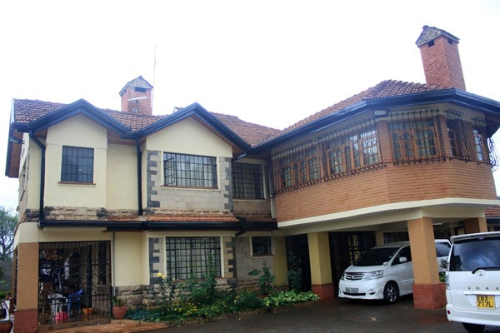
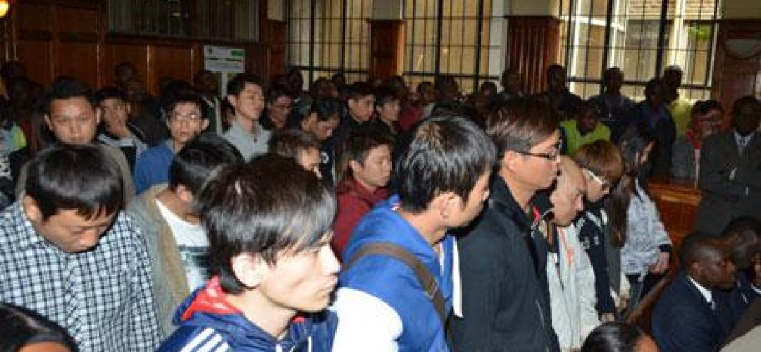
Whom are you trying to catch?
Black Hat Hacker
White Hat Hacker
Gray – Hat Hacker
Cracker

Slide 20
Attack Tools
Vulnerability Scanners – collects information about any known weaknesses on a target computer or network. The scanner works by sending specially crafted messages to select computers. How a computer responds indicates whether a specific weakness exists.
Wardialers – Before an attack is carried out an attacker must identify a target. A wardialer is used to achieve this. It dials telephone numbers looking a computer on the other end. It then logs and enters into a database those numbers that successfully connect to a modem. Used when dial-up modems were used to connect to the internet.
We shall concentrate on Sniffers and Scanners.

Slide 21
Attack Tools - Sniffer
A program or device that captures vital information from the network traffic specific to a particular network  Sniffing is a data interception technology.
The objective of sniffing is to steal:
• Passwords (from email, the web, SMB, ftp, SQL, or telnet)
• Email text
• Files in transfer (email files, ftp files, or SMB)

Slide 22
Attack Tools - Sniffers
~ Protocols that are susceptible to sniffers include:
• Telnet and Rlogin: Keystrokes including user names and passwords
• HTTP: Data sent in clear text
• SMTP: Passwords and data sent in clear text
• NNTP: Passwords and data sent in clear text
• POP: Passwords and data sent in clear text
• FTP: Passwords and data sent in clear text
• IMAP: Passwords and data sent in clear text

Slide 23
Attack Tools - Sniffer
~ There are two types of sniffing
• Passive sniffing
- Sniffing through a Hub
• Active sniffing
- Sniffing through a Switch

Slide 24
Attack Tools - HTTP Sniffer: EffeTech
 An HTTP protocol packet sniffer and network analyzer  Captures IP packets containing HTTP protocol  Enables on-the-fly content viewing while monitoring and analyzing
 Parses and decodes HTTP protocol, and generates a web traffic report for reference

Slide 25
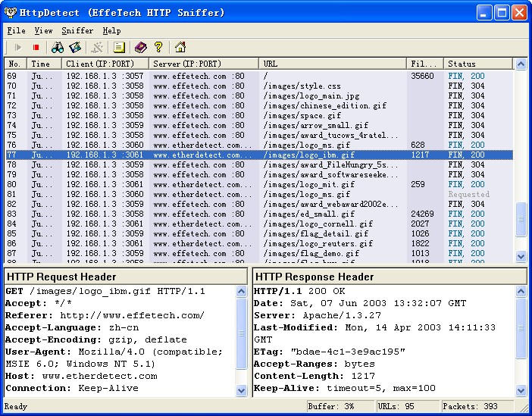
Attack Tools - HTTP Sniffer: EffeTech
 Parses and decodes HTTP protocol, and generates a web traffic report for reference

Slide 26
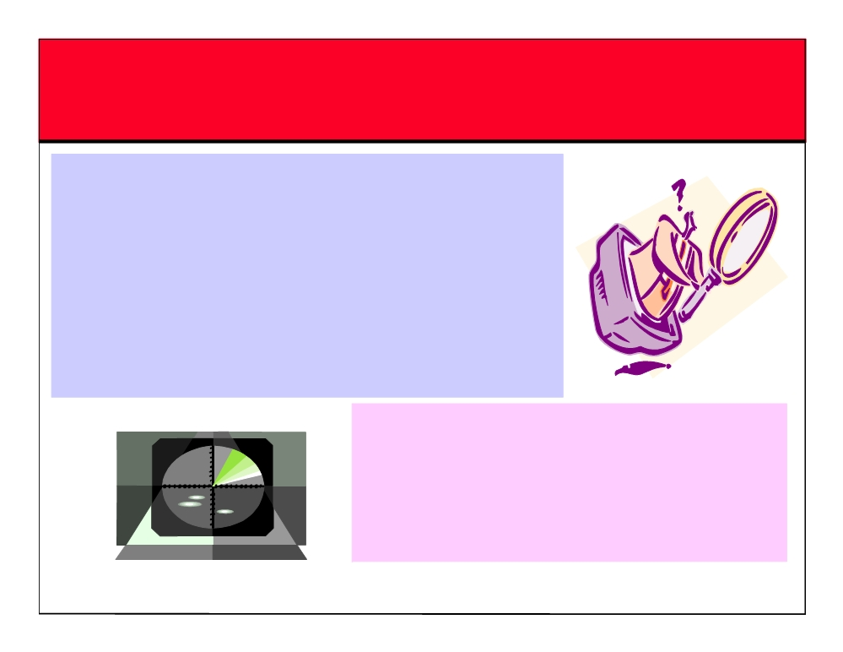
Scanning - Definition
~ One of the three components of intelligence gathering for an attacker
~ The attacker finds information about the
• specific IP addresses
• Operating Systems
• system architecture
• services running on each computer
The various types of scanning are as follows: ~Port Scanning
~Network Scanning ~Vulnerability Scanning

Slide 27

Objectives of Scanning
~ To detect the live systems running on the network
~ To discover which ports are active/running
~ To discover the operating system running on the target system (fingerprinting)
~ To discover the services
running/listening on the target system
~ To discover the IP address of the target system

Slide 28
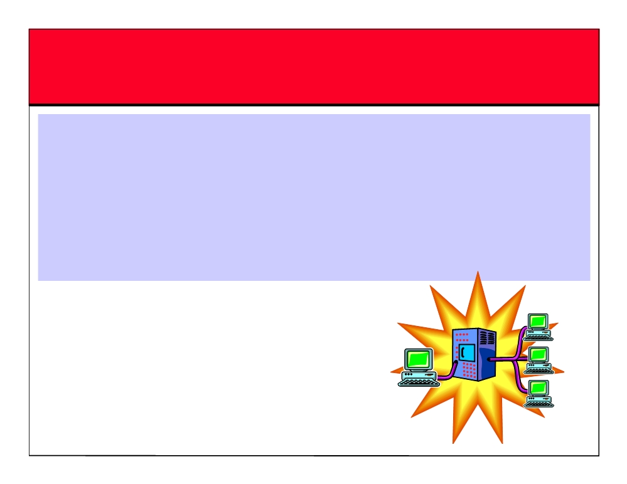
Checking for Live Systems - ICMP
Scanning
~ In this type of scanning, it is found out which hosts are up in a network by pinging them all
~ ICMP scanning can be run parallel so that it can run fast
~ It can also be helpful to tweek the ping timeout value with the -t option

Slide 29
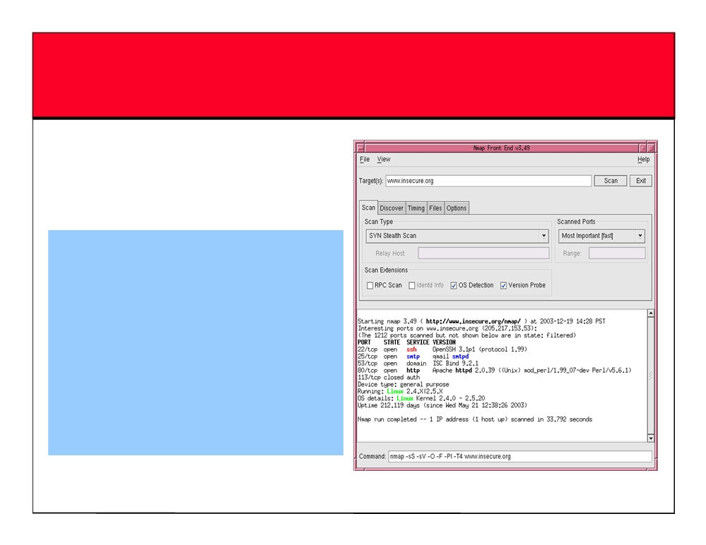
Nmap
~ Nmap is a free open source utility for network exploration
~ It is designed to rapidly scan large networks
Features
~ Nmap is used to carry out
port scanning, OS detection,
version detection, ping sweep,
and many other techniques
~ It scans a large number of machines at one time
~ It is supported by many operating systems
~ It can carry out all types of port scanning techniques

Slide 30

TCP Communication Flags
~ Standard TCP communications are controlled by flags in the TCP packet header ~ The flags are as follows:
• Synchronize - also called "SYN” - Used to initiate a connection between hosts
• Acknowledgement - also called "ACK” - Used in establishing a connection between hosts
• Push - "PSH”
Instructs receiving system to send all buffered data immediately
• Urgent - "URG”
- States that the data contained in the packet should be processed immediately
• Finish - also called "FIN"
Tells remote system that there will be no more transmissions
• Reset - also called "RST”
- Also used to reset a connection

Slide 31

Three Way Handshake
Computer A
Computer B
192.168.1.2:2342------------syn--------->192.168.1.3:80
192.168.1.2:2342<-------syn/ack------ 192.168.1.3:80
192.168.1.2:2342------------ack------- >192.168.1.3:80
Connection Established
~ The Computer A ( 192.168.1.2 ) initiates a connection to the server ( 192.168.1.3 ) via a packet with only the SYN flag set
~ The server replies with a packet with both the SYN and the ACK flag set ~ For the final step, the client responds back the server with a single ACK packet
~ If these three steps are completed without complication, then a TCP connection has
been established between the client and server

Slide 32

SYN Stealth / Half Open Scan
~ It is often referred to as half open scan because it does not open a full TCP connection
~ First a SYN packet is sent to a port of the machine, suggesting a request for connection, and the response is awaited
~ If the port sends back a SYN/ACK packet, then it is inferred that a service at the particular port is listening. If an RST is received, then the port is not active/ listening. As soon as the SYN/ACK packet is received, an RST packet is sent, instead of an ACK, to tear down the connection
~ The key advantage is that fewer sites log this scan

Slide 33
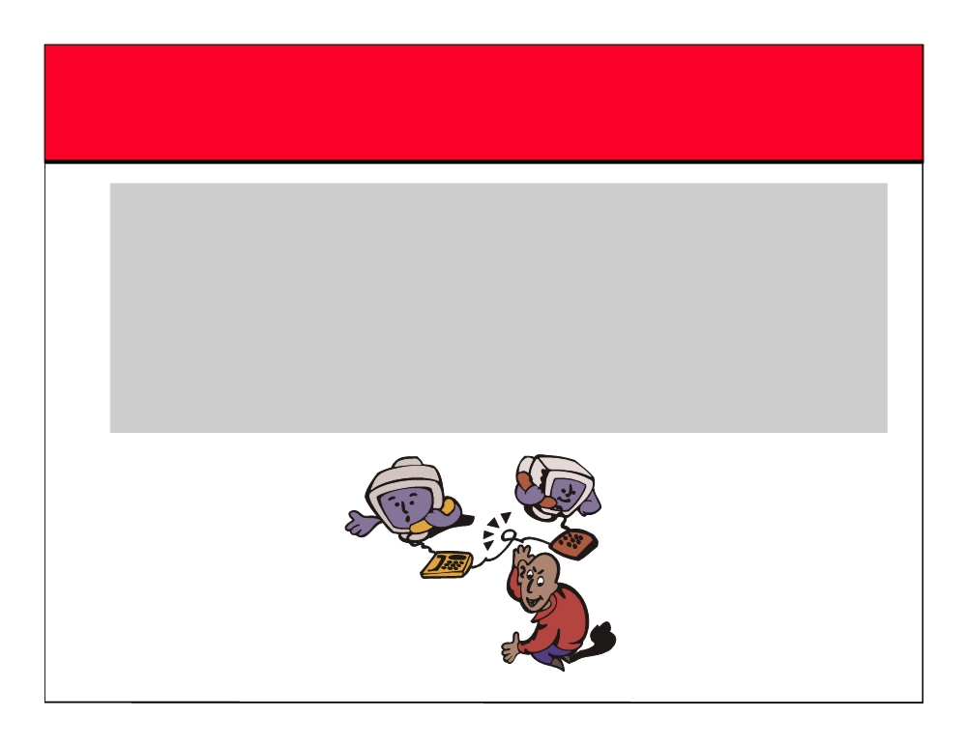
IDLE Scan
~ Almost four years ago, security researcher Antirez posted an innovative new TCP port scanning technique
~ IDLE Scan, as it has become known, allows for completely blind port scanning
~ Attackers can actually scan a target without sending a single packet to the target from their own IP address

Slide 34

IDLE Scan: Basics
~ Most network servers listen on TCP ports, such as web servers on port 80 and mail servers on port 25
~ A port is considered "open" if an application is listening on the port, otherwise it is closed
~ One way to determine whether a port is open is to send a "SYN" (session establishment) packet to the port
~ The target machine will send back a "SYN|ACK" (session request acknowledgment) packet if the port is open, and an "RST" (Reset) packet if the port is closed
~ A machine which receives an unsolicited SYN|ACK packet will respond with an RST. An unsolicited RST will be ignored
~ Every IP packet on the Internet has a "fragment identification" number ~ Many operating systems simply increment this number for every packet they send ~ So probing for this number can tell an attacker how many packets have been sent since the last probe

Slide 35
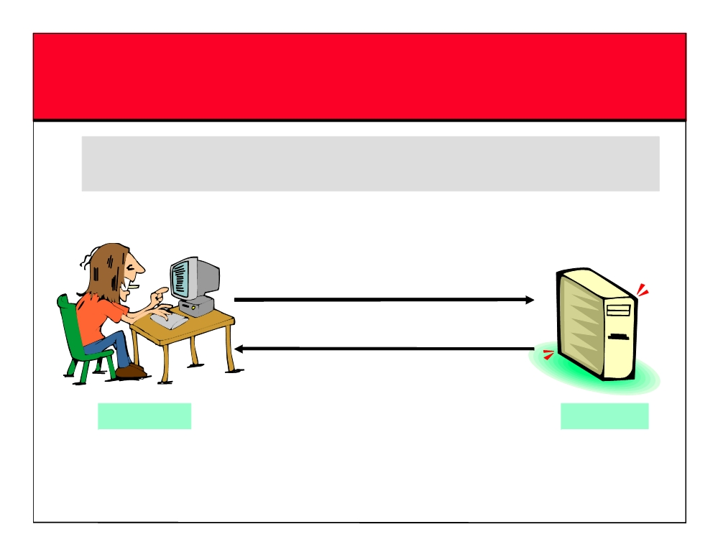
IDLE Scan: Step 1
~ Choose a "zombie" and probe for its current IPID number
IPID Probe
SYN / ACK Packet
Response: IPID=31337 RST Packet
Attacker
Zombie

Slide 36
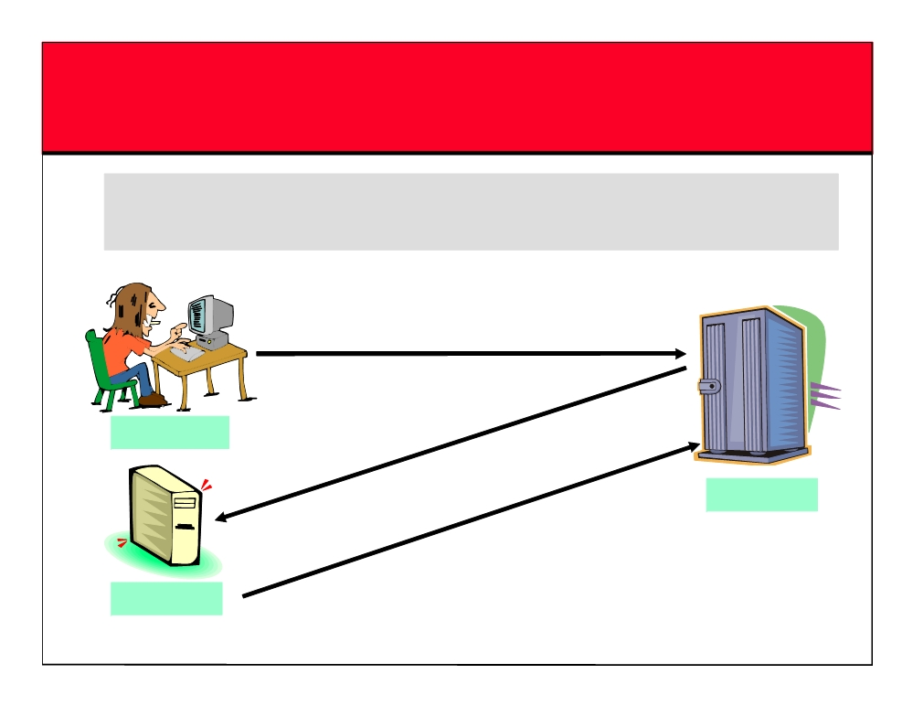
IDLE Scan: Step 2.1 (Open Port)
~ Send SYN packet to target machine spoofing the IP address of the “zombie”
SYN Packet to port 80 spoofing zombie IP address
SYN/ACK Packet (if port open)
Attacker
Target
IPID=31338
Zombie

Slide 37
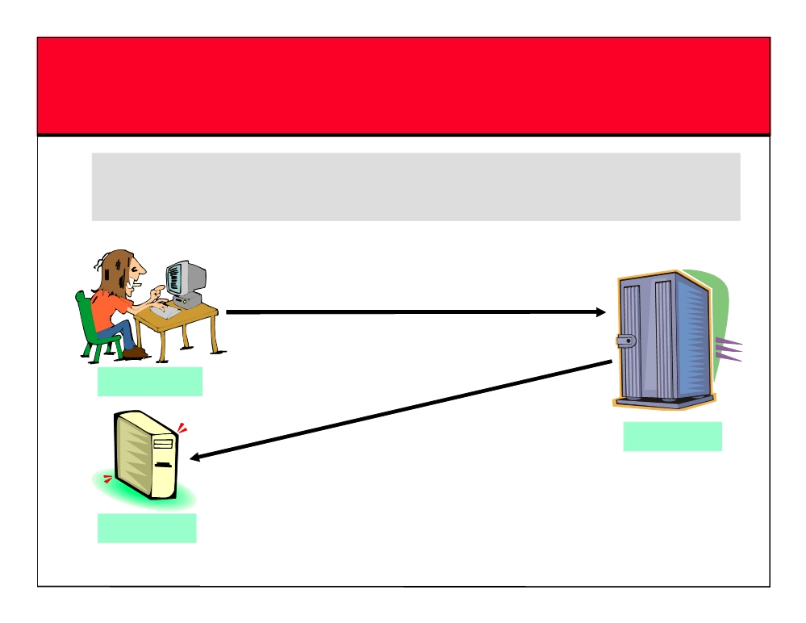
IDLE Scan: Step 2.2 (Closed Port)
~ The target will send RST to the “zombie” if port is closed. Zombie will not send anything back
SYN Packet to port 80
spoofing zombie IP address
Attacker
RST (if port closed)
Target
Zombie

Slide 38

IDLE Scan: Step 3
~ Probe “zombie" IPID again
IPID Probe
SYN / ACK Packet
Response: IPID=31339 RST Packet
Attacker
IPID incremented by 2 since
Zombie
Step 1 so port 80 must be open!

Slide 39
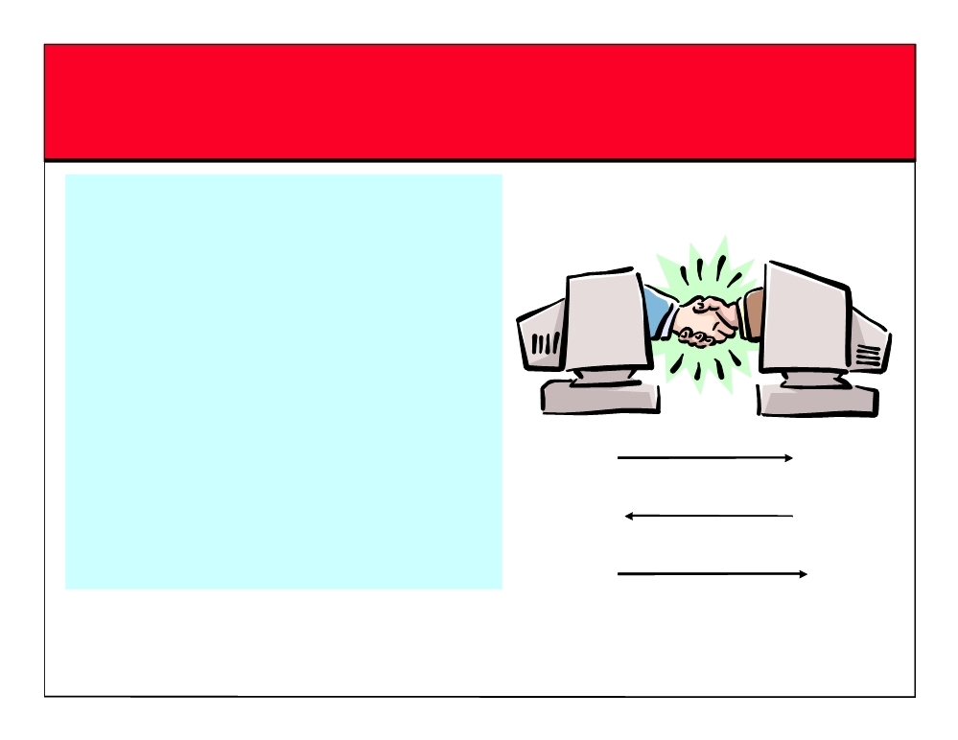
TCP Connect / Full Open Scan
~ This is the most reliable form of
TCP scanning. The connect() system call provided by the operating system is used to open a connection to every open port on
the machine
SYN
~ If the port is open, connect() will
SYN
+
ACK
succeed. If the port is closed, then it
is unreachable
ACK

Slide 40

FloppyScan
Interesting ports on 192.168.100.5:
Floppyscan is a dangerous
(The 1646 ports scanned but not
~
hacking tool which can be used
shown below are in state: closed)
to portscan a system using a
PORT
STATE SERVICE
floppy disk
53/tcp open domain
88/tcp open kerberos-sec
~
Boots up mini Linux
135/tcp open msrpc
Displays “Blue screen of death”
139/tcp open netbios-ssn
~
screen
389/tcp open ldap
Port scans the network using
445/tcp open microsoft-ds
~
464/tcp open kpasswd5
NMAP
593/tcp open http-rpc-epmap 636/tcp open ldapssl
~Sends the results by e-mail to a
remote server
1025/tcp open NFS-or-IIS
1026/tcp open LSA-or-nterm 3268/tcp open globalcatLDAP 3269/tcp open globalcatLDAPssl

Slide 41
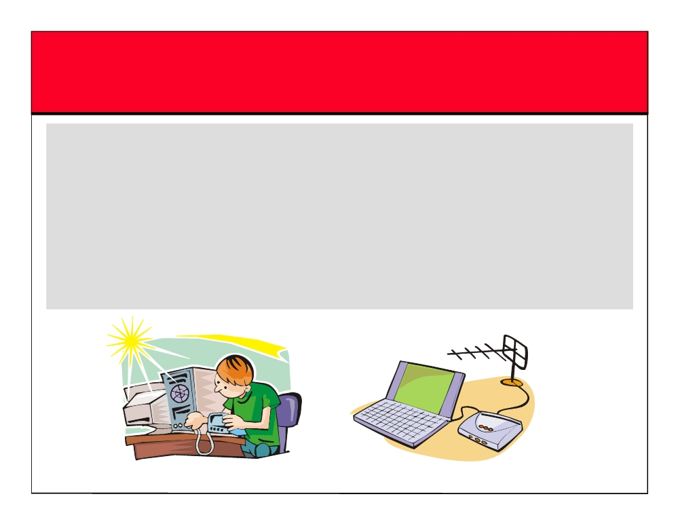
War Dialer Technique
~ War dialing involves the use of a program in conjunction with a modem to penetrate the modem-based systems of an organization by continually dialing in ~ Companies do not control the dial-in ports as strictly as the firewall, and machines with modems attached are present everywhere
~ A tool that identifies the phone numbers that can successfully make a connection with a computer modem
~ It generally works by using a predetermined list of common user names and passwords in an attempt to gain access to the system

Slide 42
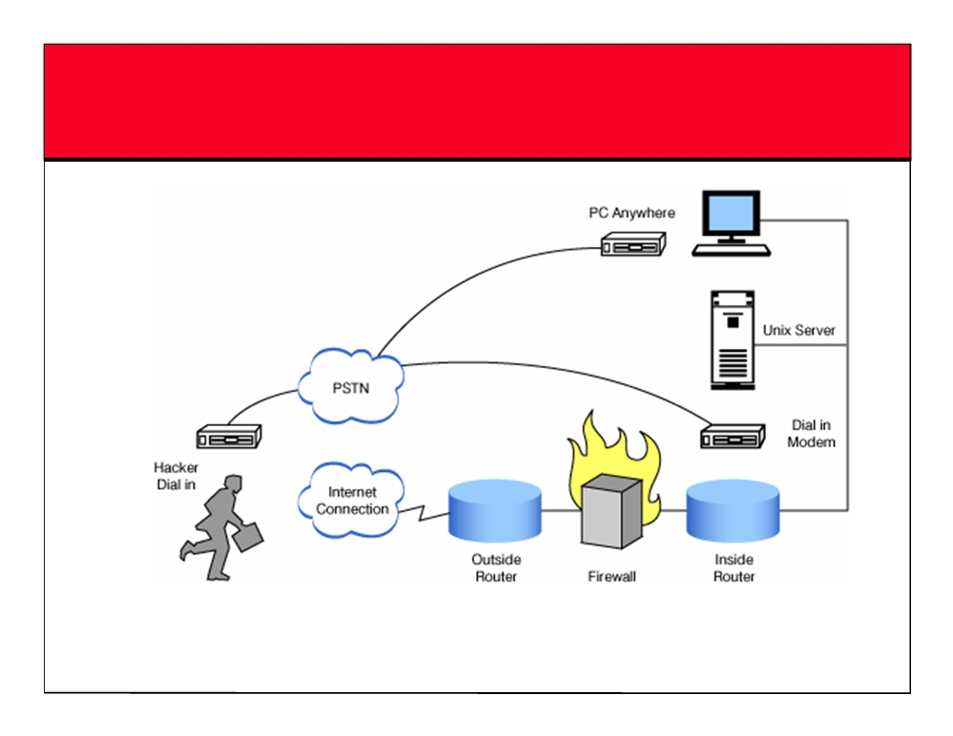
Wardialing

Slide 43
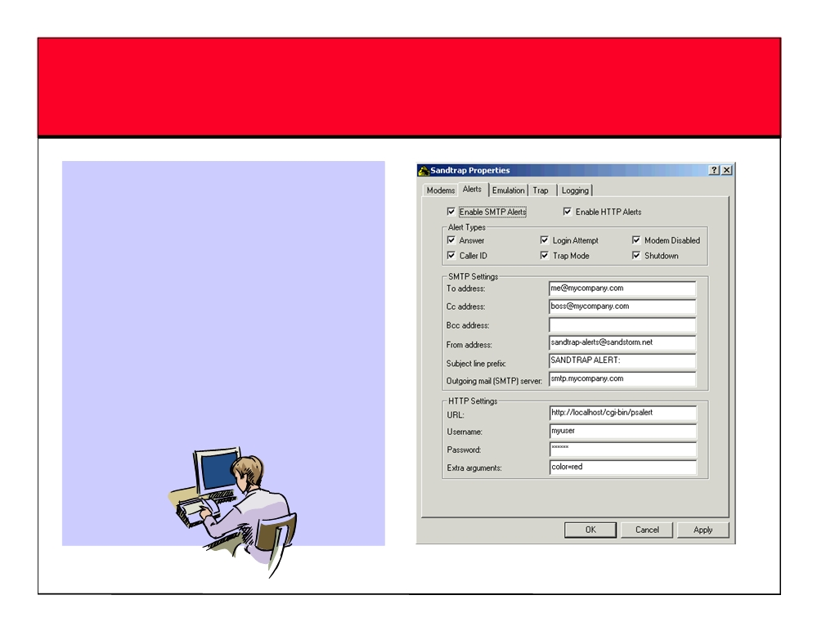
War Dialing Countermeasures SandTrap Tool
~Sandtrap can detect war dialing attempts and notify the
administrator immediately upon being called, or upon being connected to, via an email message, pager or via HTTP POST to a web server
~Conditions that can be configured to generate notification messages include:
• Incoming Caller ID • Login attempt

Slide 44
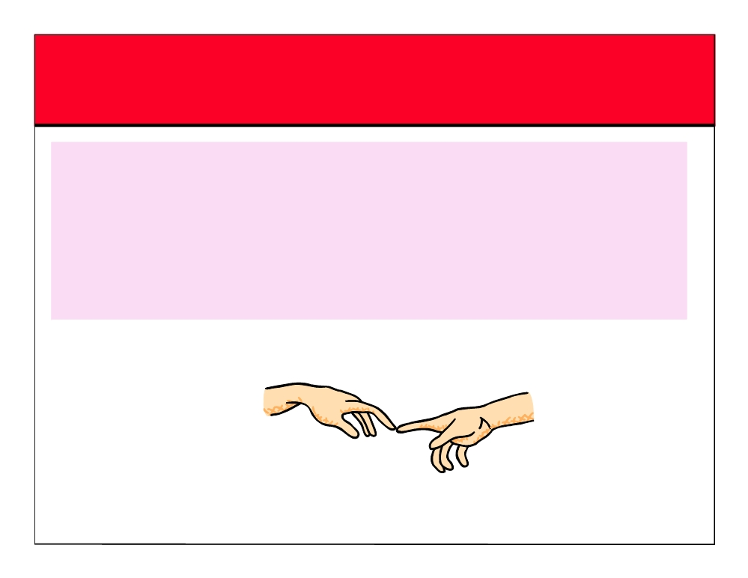
OS Fingerprinting
~ OS fingerprinting is the method to determine the operating system that is running on the target system
~ The two different types of fingerprinting are: • Active stack fingerprinting
• Passive fingerprinting

Slide 45
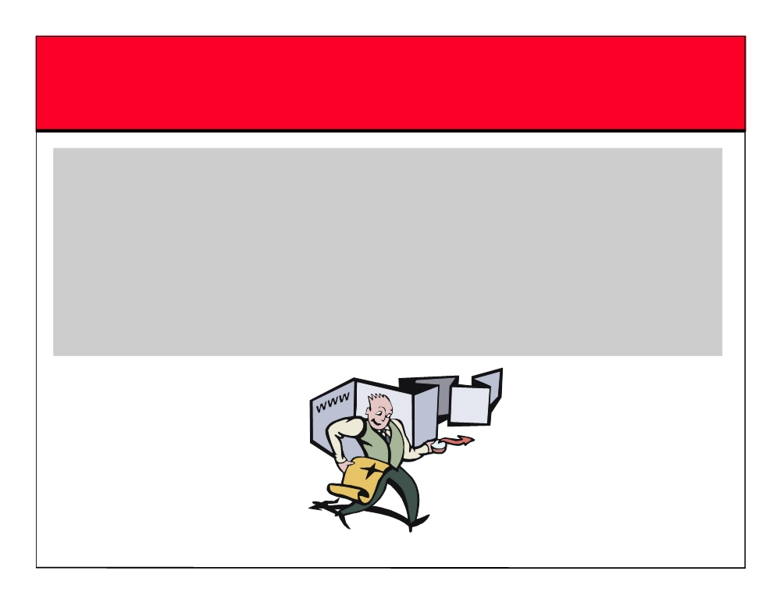
Active Stack Fingerprinting
~ Based on the fact that OS vendors implement the TCP stack differently
~ Specially crafted packets are sent to remote OSs and response is noted
~ The responses are then compared with a database to determine the OS
~ The Firewall logs your active banner grabbing scan since you are probing directly

Slide 46

Passive Fingerprinting
~ Passive banner grabbing refers to indirectly scanning a system to reveal its server’s operating system
~ It is also based on the differential implantation of the stack and the various ways an OS responds to it
~ It uses sniffing techniques instead of the scanning techniques
~ It is less accurate than active fingerprinting

Slide 47
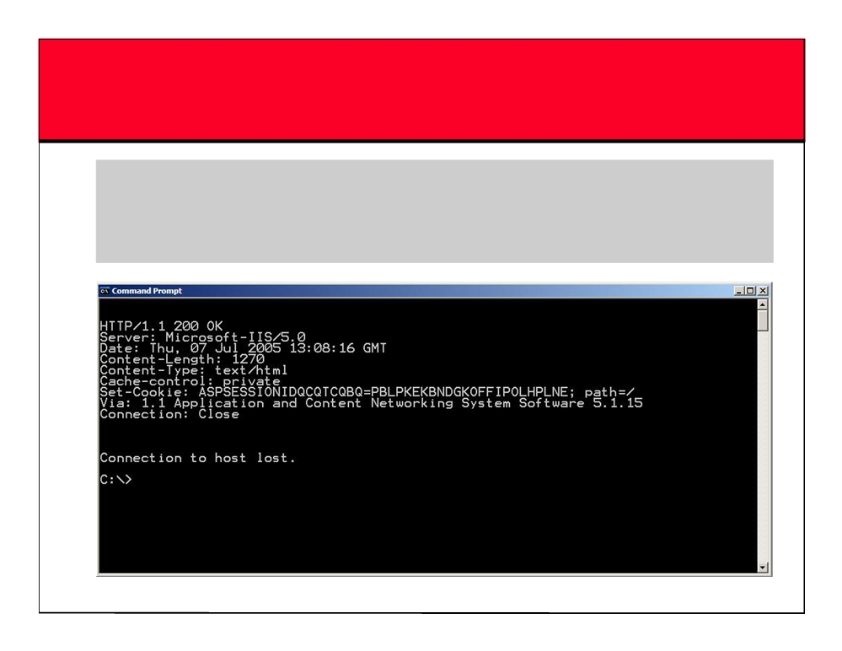
Active Banner Grabbing Using Telnet
~ You can use telnet to grab the banner of a website telnet www.certifiedhacker 80
HEAD / HTTP/1.0

Slide 48

Httprint Banner Grabbing Tool
~ httprint is a web server fingerprinting tool
~ It relies on web server characteristics to accurately identify web servers, despite the fact that they may have been obfuscated by changing the server banner strings, or by plug-ins such as mod_security or servermask
~ httprint can also be used to detect web-enabled devices which do not have a server banner string, such as wireless access points, routers, switches, and cable modems
~ httprint uses text signature strings, and it is very easy to add signatures to the signature database
EC-Council

Slide 49

Disabling or Changing Banner
~ Apache Server
• Apache 2.x users who have the mod_headers module loaded can use a simple directive in their httpd.conf file to change banner information Header set Server "New Server Name“
• Apache 1.3.x users have to edit defines in httpd.h and recompile Apache to get the same result
~ IIS Server
• IIS users can use following tools to disable or change banner information
- IIS Lockdown Tool
- ServerMask

Slide 50

IIS Lockdown Tool
~ IIS Lockdown Wizard version 2.1 is used to turn off unnecessary features to reduce attack surface available to attackers
~ System Requirements:
• Supported Operating Systems: Windows 2000; Windows NT; Windows XP
• Windows NT 4.0 running IIS 4.0, Windows 2000 running IIS 5.0, or Windows XP running IIS 5.1

Slide 51

Proxy Servers
~ Proxy is a network computer that can serve as an intermediate for connection with other computers ~ They are usually used for the following purposes:
• As a firewall, a proxy protects the local network from outside access
• As an IP addresses multiplexer, a proxy allows the connection of a number of computers to the Internet when having only one IP address
• Proxy servers can be used (to some extent) to anonymize web surfing
• Specialized proxy servers can filter out unwanted content, such as ads or 'unsuitable' material • Proxy servers can afford some protection against hacking attacks

Slide 52
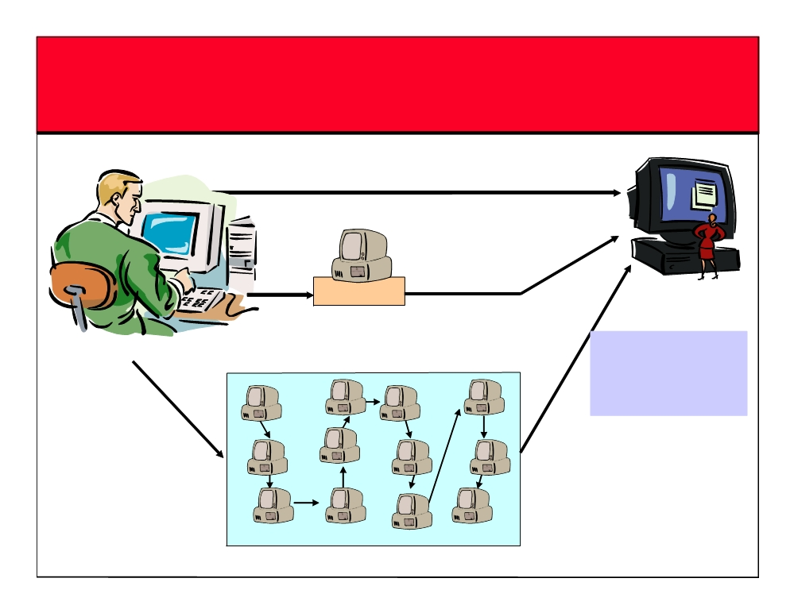
Use of Proxies for Attack
DIRECT ATTACK/ NO PROXIES
(1)
Logged proxy
PROXY
(2)
VICTIM
ATTACKER
The last proxy IP address
CHAIN OF PROXIES
is logged. There can be
thousands of proxies used in the attack process. Traceback can be extremely difficult
(3)

Slide 53
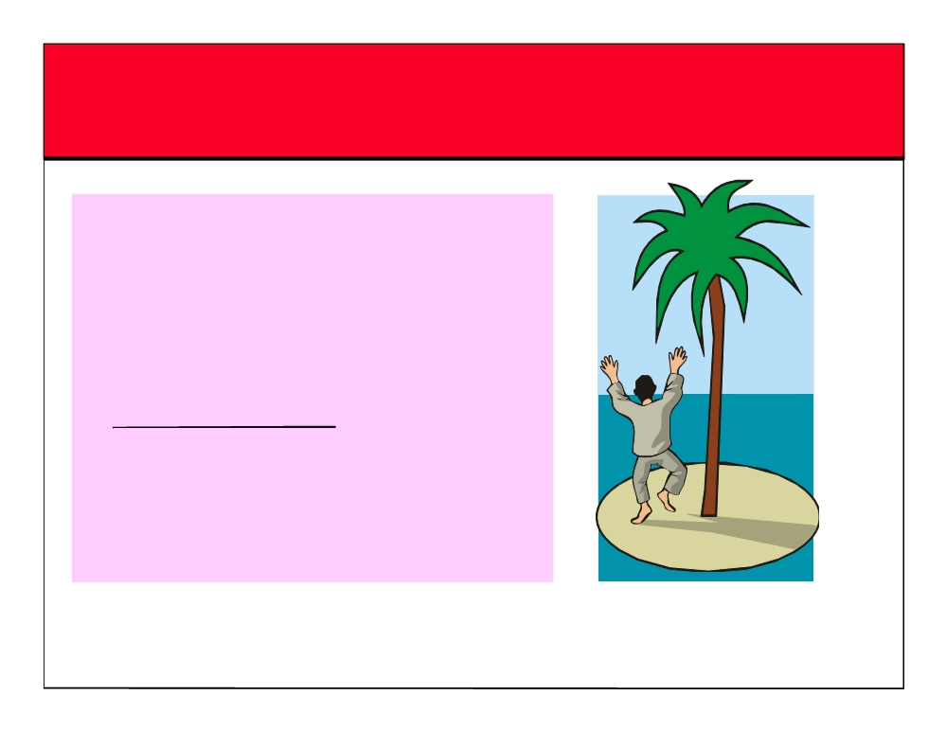
Anonymizers
~ Anonymizers are services that help to make web surfing anonymous
~ The first anonymizer developed was Anonymizer.com, created in 1997 by Lance Cottrell ~ An anonymizer removes all the identifying information from a user’s computers while the user surfs the Internet, thereby ensuring the privacy of the user
~ Why Use Anonymizer?
• Example: Google.com keeps track of all your web searches on their servers by placing a cookie on your machine
• Every single search you entered at Google is logged

Slide 54
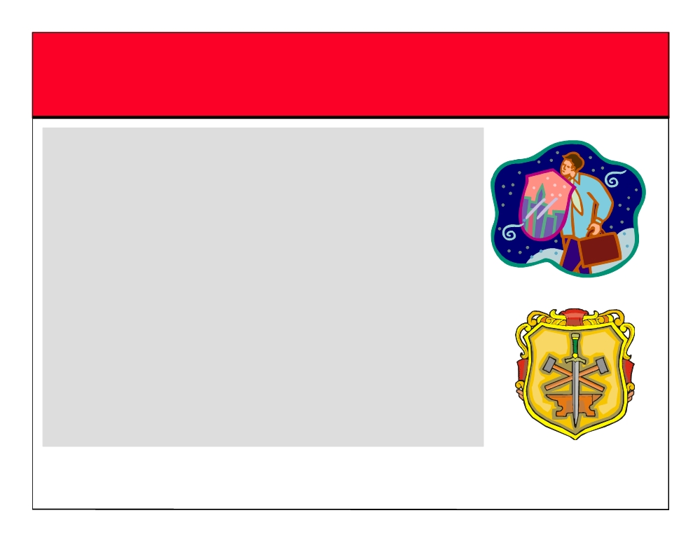
Scanning Countermeasures
~ The firewall of a particular network should be good enough to detect the probes of an attacker. The firewall should carry out stateful inspection, with it having a specific rule set
~ Network intrusion detection systems should be used to find out the OS detection method used by some tools such as Nmap
~ Only necessary ports should be kept open and the rest should be filtered
~ All sensitive information that is not to be disclosed to the public over the Internet should not be displayed

Slide 55

Summary
~ Scanning is one of three components of intelligence gathering for an attacker
~ The objective of scanning is to discover live systems, active/running ports, the Operating Systems, and the Services running on the network
~ Some of the popular scanning tools are Nmap, Nessus, and Retina
~ A chain of proxies can be created to evade the traceback of the attacker

Slide 56
Security Breach – What is it?
Any event that results in a violation of an of the C-I-A security tenents is a security breach.
AIC or CIA
The security triad includes:
Confidentiality: ensures that only authorized people can access resources
Integrity: prevents the unauthorized modification of data
Availability: ensures that all resources (systems and data) are available when needed

Slide 57
Security Breach – What is it?
2. Confidentiality
Authentication: ensures that everyone who accesses data is authenticated. (Figuring out who is accessing data)
Authorization: controls who can access the data * Encryption: ensures that data cannot be readable until it’s decrypted.
3. Integrity
Integrity looks similar with confidentiality. Integrity focused on the stability of the data such as prevents unauthorized users from hampering data. Hashing is an example.

Slide 58
Security Breach – What is it?
By comparing hash values (old and new), you can detect whether data has been modified or not.
Auditing: logs who is accessing and modifying data
Hashing:
4. Availability
Loss of data can be disastrous or even catastrophic in your business.
Backup
RAID (Redundant Arrays of Independent Disks)
Malware protection

Slide 59
Types of Security Breaches
Denial of Service Attack
Distributed Denial of Service Attack
Unacceptable Web Browsing
Wiretapping
Backdoor
Data Modifications
Spam
Hoaxes
Cookies

Slide 60
Vulnerabilities & Threats
A vulnerability is any weakness in a system that makes it possible for a threat to cause it harm.
Threats exploit one or more known vulnerabilities
Vulnerabilities exist in any organisation.

Slide 61
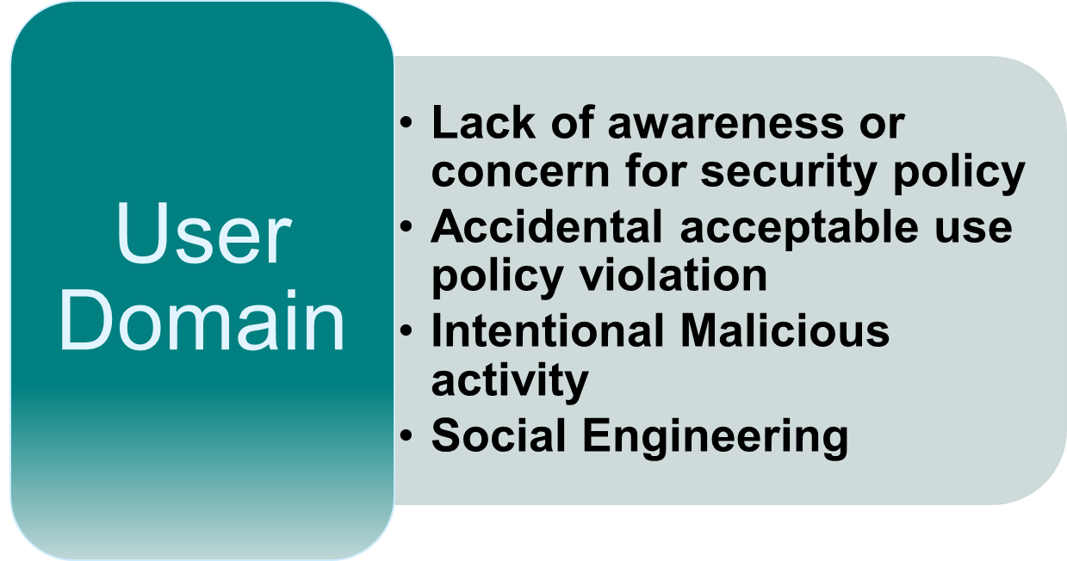
Common Vulnerabilities in any Organization

Slide 62
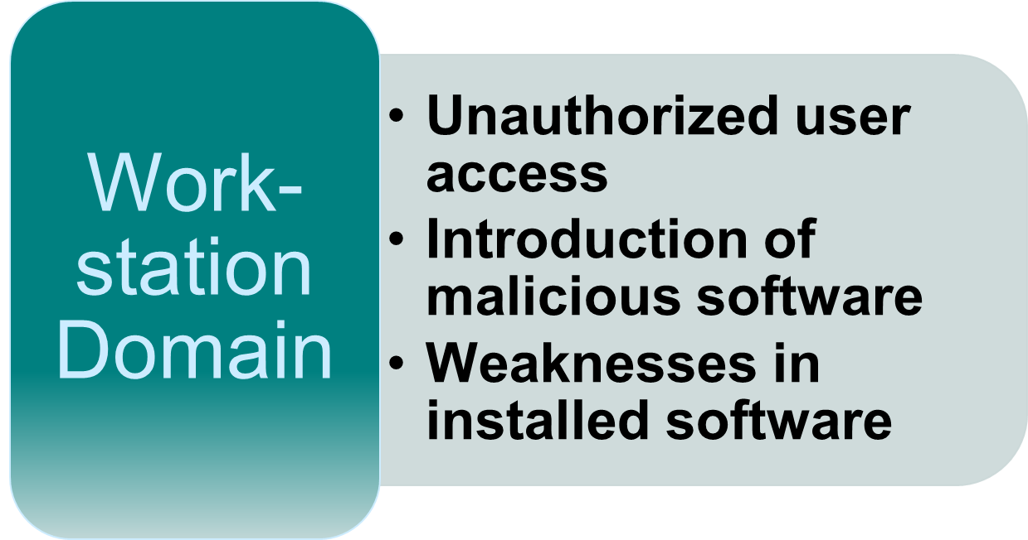
Common Vulnerabilities in any Organization

Slide 63
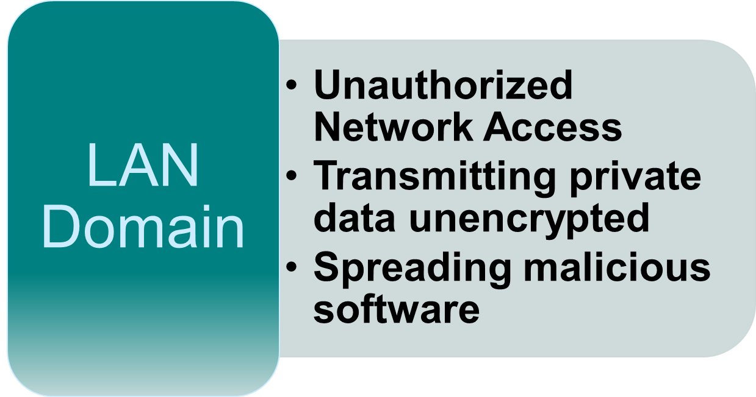
Common Vulnerabilities in any Organization

Slide 64
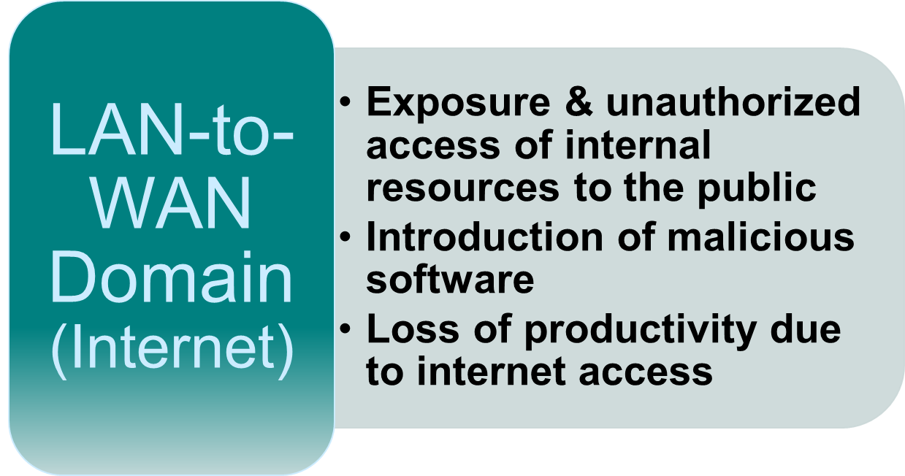
Common Vulnerabilities in any Organization

Slide 65
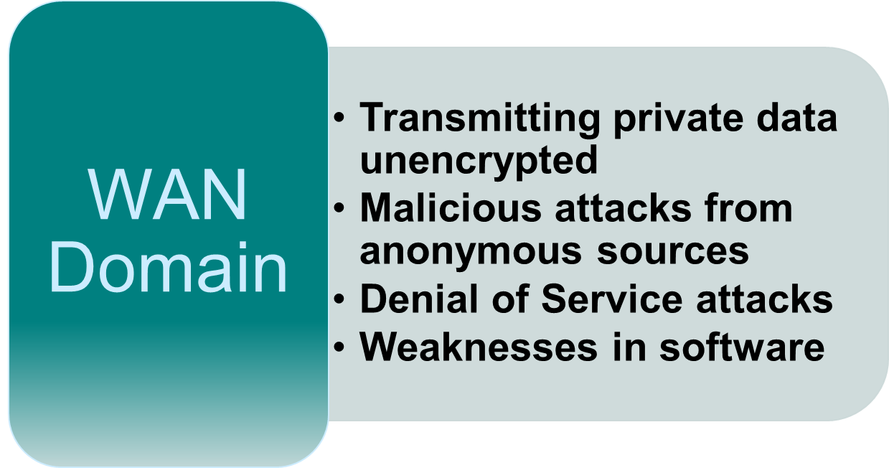
Common Vulnerabilities in any Organization

Slide 66
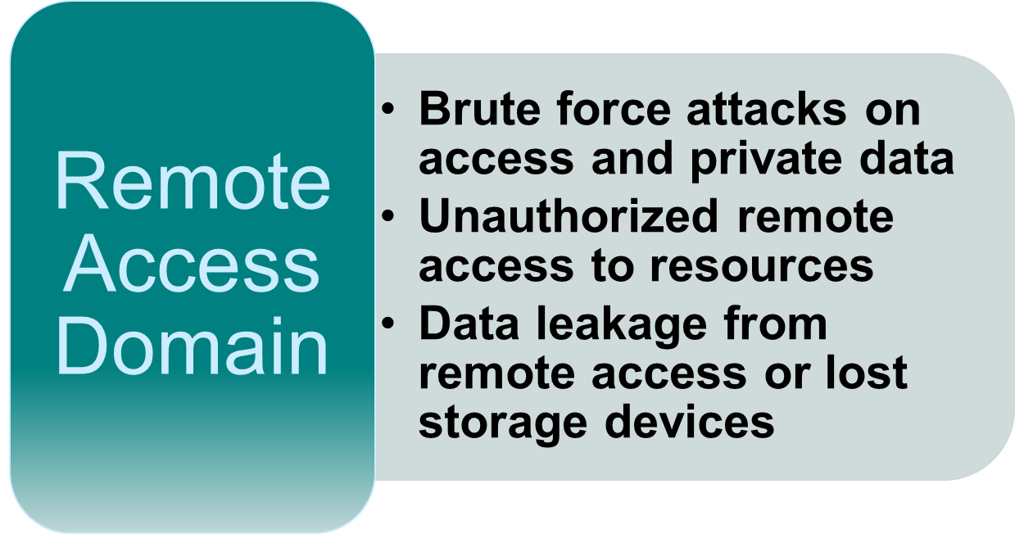
Common Vulnerabilities in any Organization

Slide 67
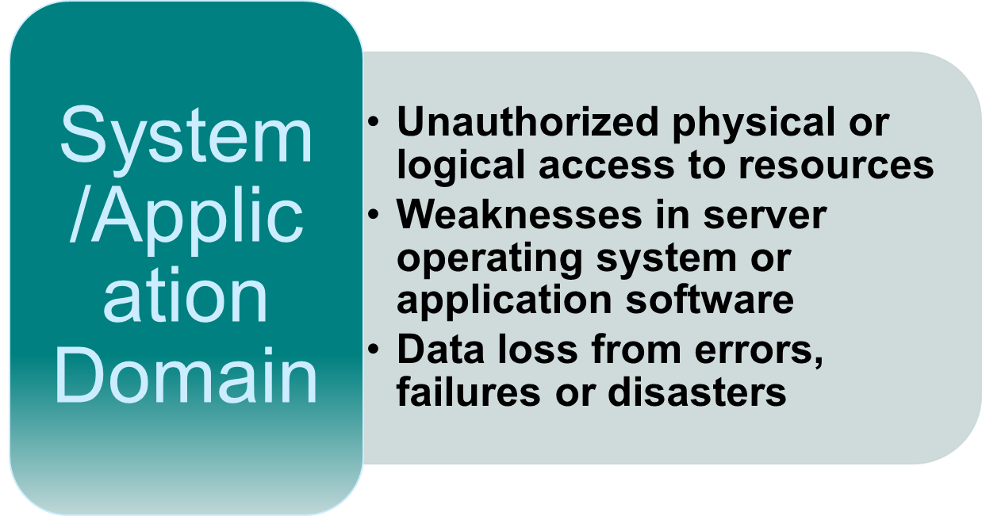
Common Vulnerabilities in any Organization

Slide 68
Common Threats
Malicious Software
Hardware or software failure
Internal Attacker
Equipment Theft
External Attacker
Natural Disaster
Industrial Espionage
Terrorism

Slide 69
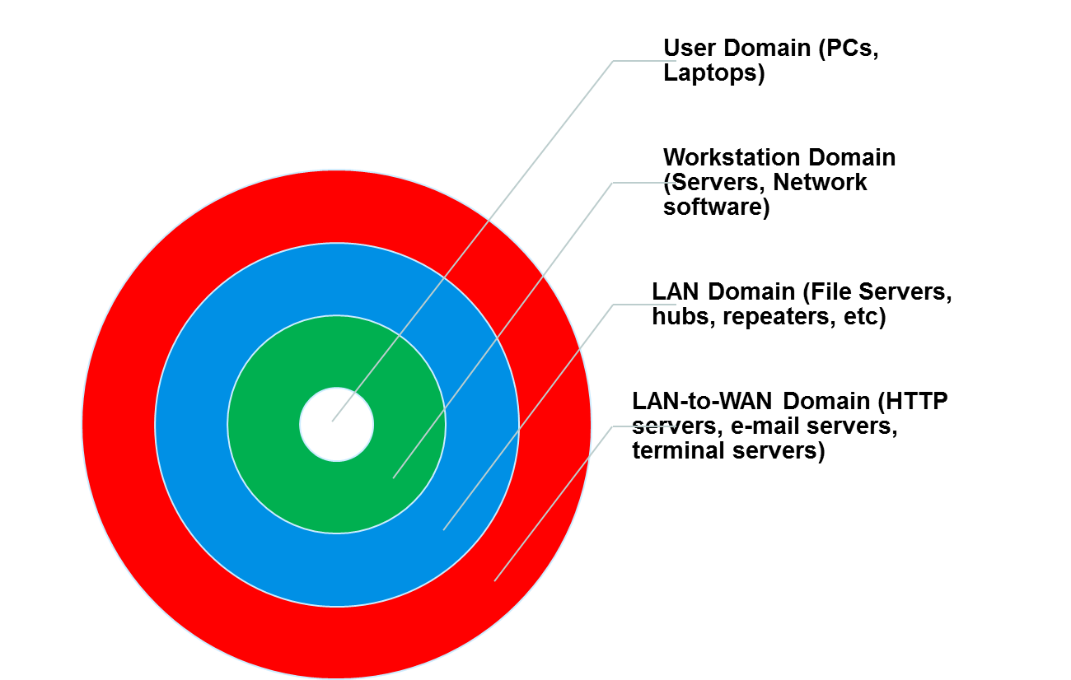
Threat Targets

Slide 70
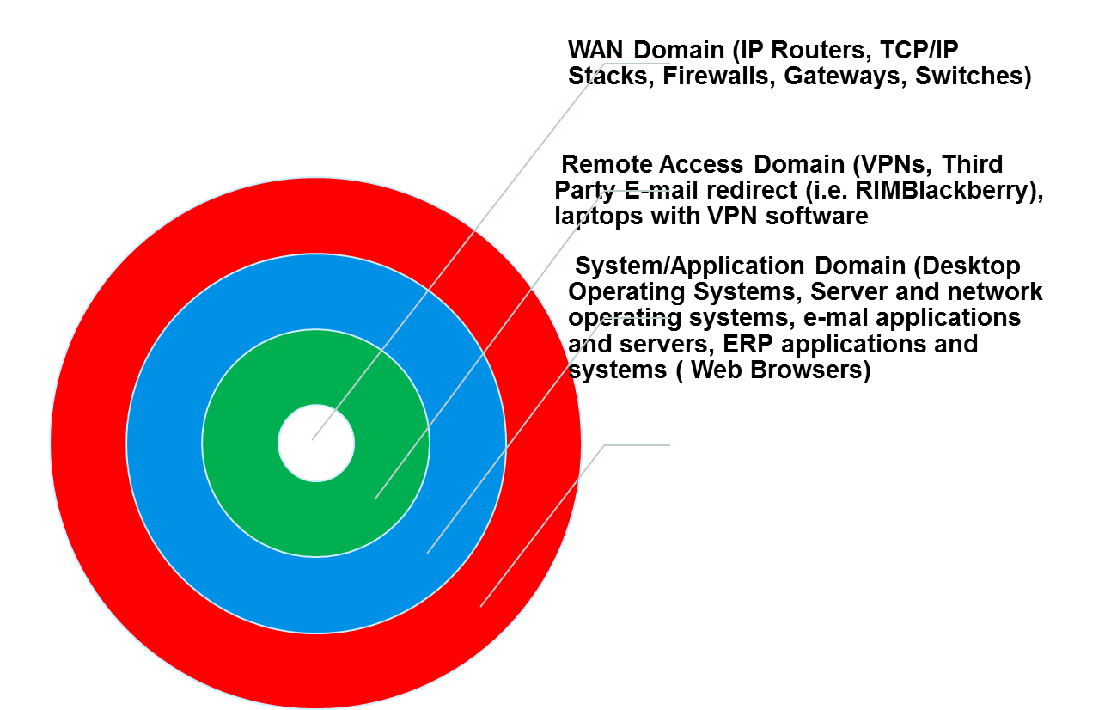
Threat Targets

Slide 71
Threat Types
Malicious Software
Hardware or software failure
Internal Attacker
Equipment Theft
External Attacker
Natural Disaster
Industrial Espionage
Terrorism

Slide 72
Malicious Attacks
An attack on a computer system or network asset succeeds by exploiting a vulnerability in the system. T
There are four general categories of attacks:
Fabrications
Interceptions
Interruptions
Modifications

Slide 73
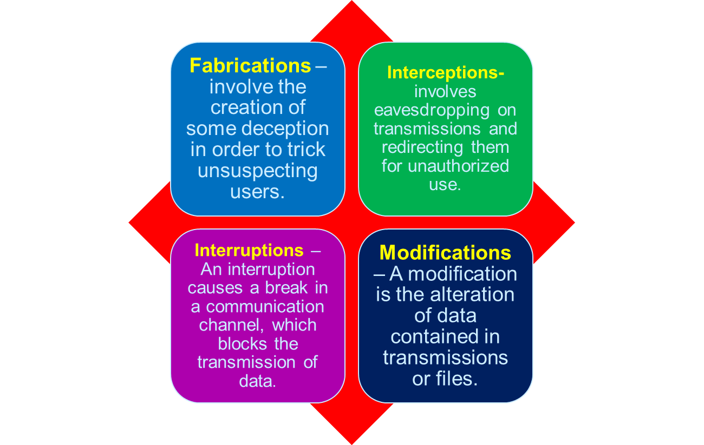
Malicious Attacks

Slide 74
Active & Passive Attacks
An active attack involves a modification of the data stream or attempts to gain unauthorized access to computer and networking systems. This is a physical intrusion.
A passive attack involves only eavesdropping and monitoring transmissions.

Slide 75
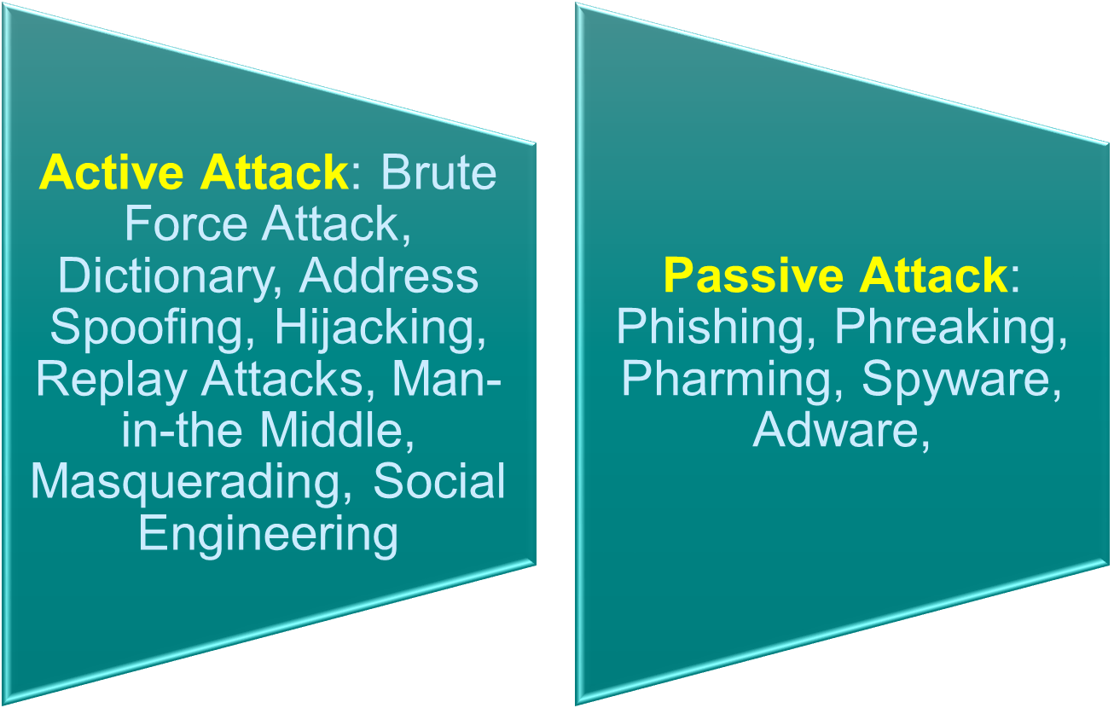
Active & Passive Attacks

Slide 76
Counter-Measures
Countering Malware – The general steps for preventing malware include:
Educate your users from installing malware
Post regular updates about malware problems
Do not transfer files from an untrusted source
Test new programs or open suspect files on a quarantine computer
Install anti-malware software e.g. Kasperskey
Use a secure logon and authentication process

Slide 77
Counter-Measures
The best counter-measure is risk management. Identify the risks, threats and vulnerabilities. Take mitigating measures that will protect the systems.
Countering Malware – Protecting using Firewalls
A firewall is a program or dedicated hardware device that inspects network traffic passing through it and denies or permits that traffic based on a set or rules you determine at configuration.
Firewall solutions e.g. Cisco Systems, Sonicwall, Checkpoint, Netgear, Nortel, Juniper.

